Slide 1
Tournament Sort
A sorting algorithm

Slide 2
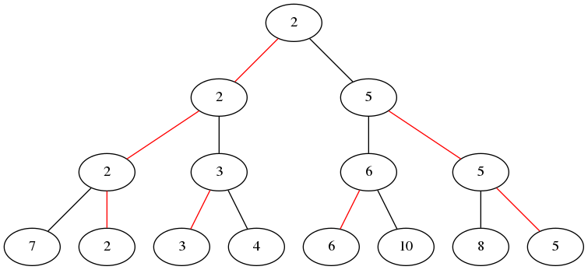
How does it work?
Tournament sort is a variation of selection sort that uses a tree instead of the traditional list. It arranges the array into a tree and uses a bracket-based comparison method to find the smallest value. This is a form of divide-and-conquer.

Slide 3

Comparing Tournament Sort to Selection Sort
With 1000 items in the list, tournament sort is faster by a lot.

Slide 4
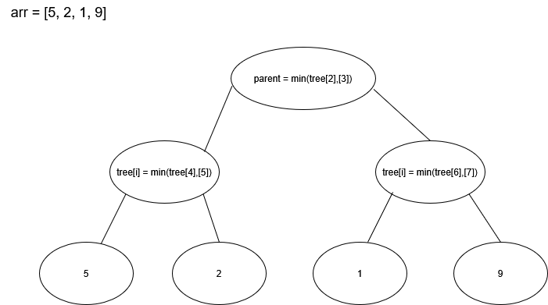
Flowchart

Slide 5
Use cases
Tournament sort is better than other sorting algorithms when sorting an extremely large dataset. Its data splitting and tree-based structure allows it to find the lowest number as efficiently as possible. The time complexity is O(n log n).

Slide 6
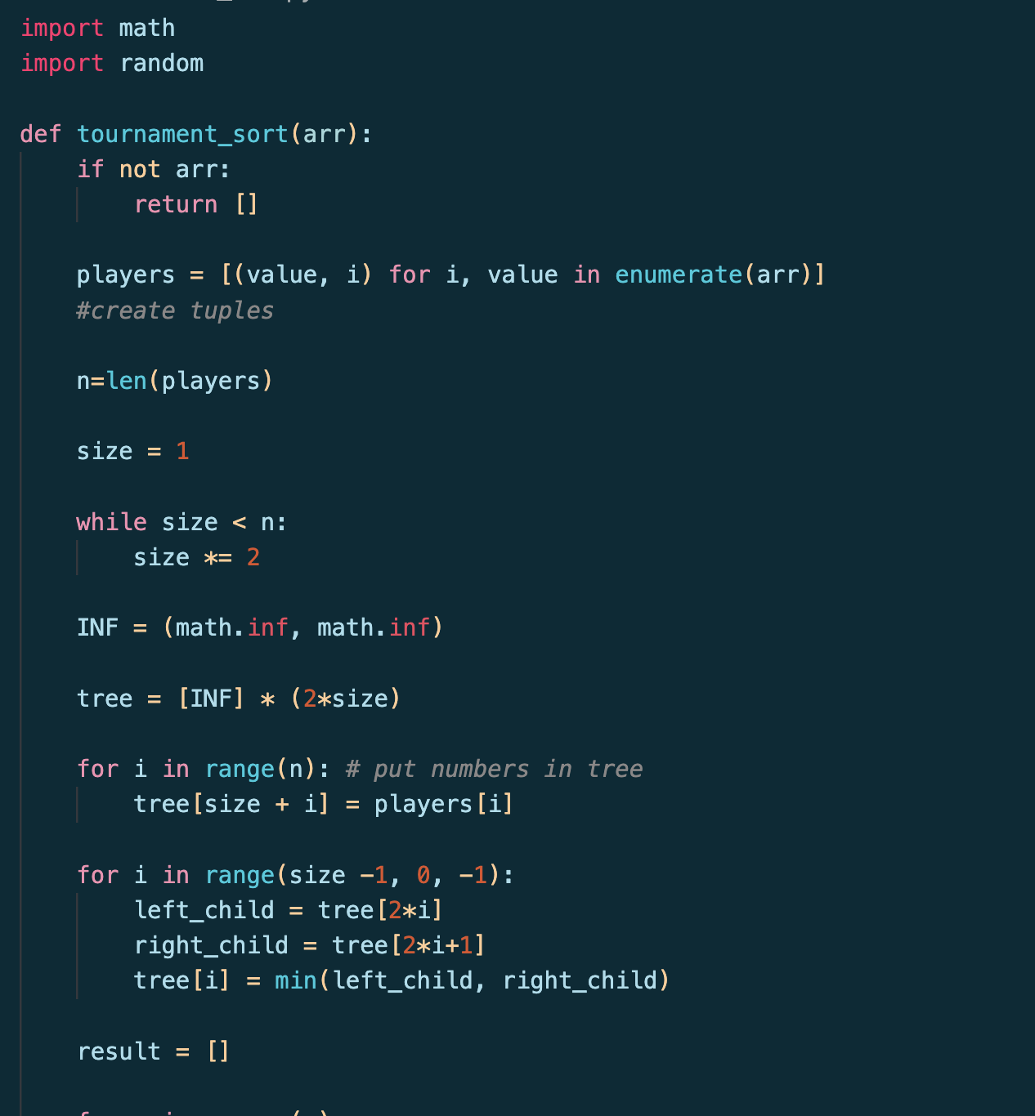
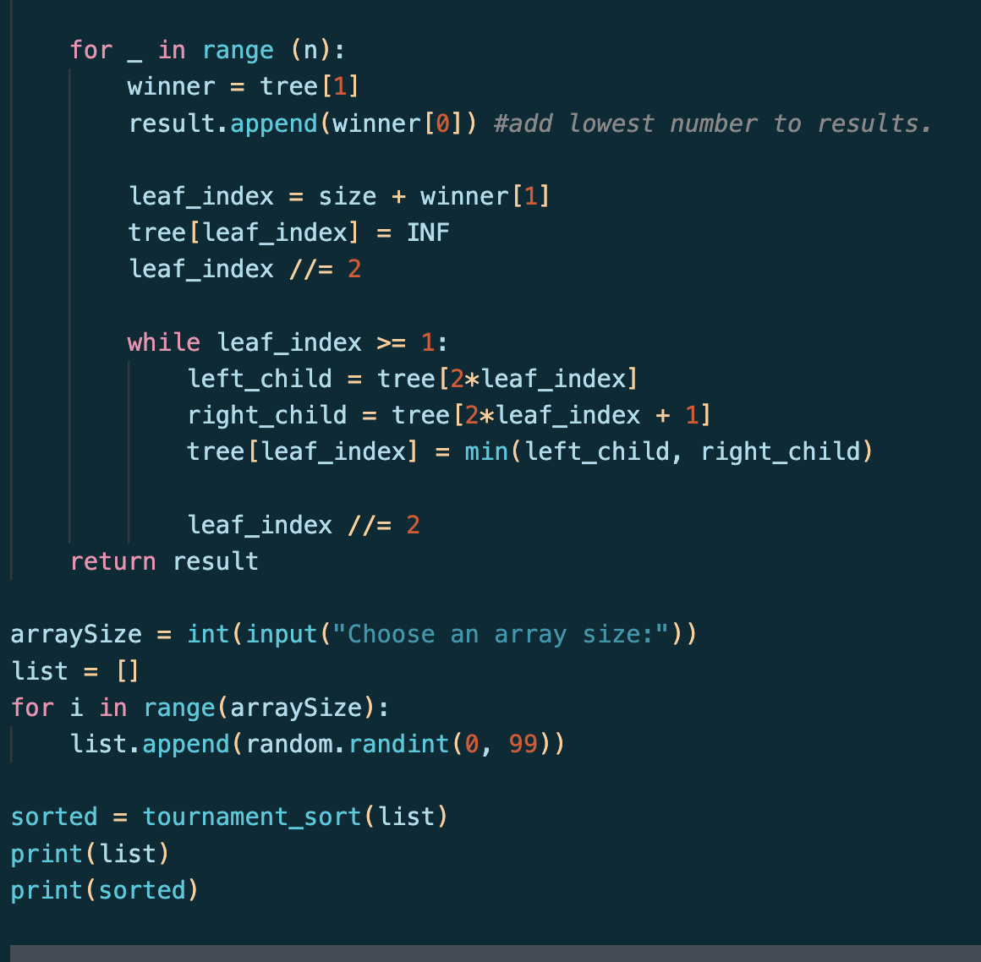
Code

Slide 7
Works cited:
Oi Wiki: OI Wiki

